Slide 1
Computer Vision Image Recognition and Object Detection
Garfield Dai

Slide 2
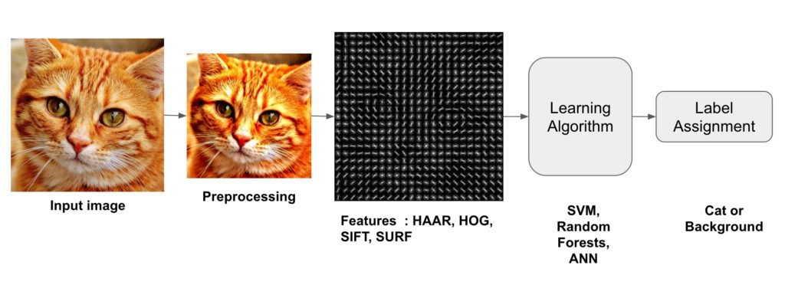
Shallow Learning

Slide 3
Shallow Learning
Preprocessing
Feature Extraction
Histogram of Oriented Gradients ( HOG )
Haar-like features ( HAAR )
Scale-Invariant Feature Transform ( SIFT )
Speeded Up Robust Feature ( SURF )
Classification Algorithm
Support Vector Machines ( SVM )
Random Forests
… …

Slide 4
History
2001: Face detection in real time on a webcam implemented in OpenCV.
2005: Object detection-> HOG in pedestrian detection.
---------------------------------------------------------------------------
2012: ImageNet Large Scale Visual Recognition Challenge (ILSVRC).
Deep Learning-> 85% / +11%.
2015: Multiple Convolutional Neural Network-> 95%.

Slide 5
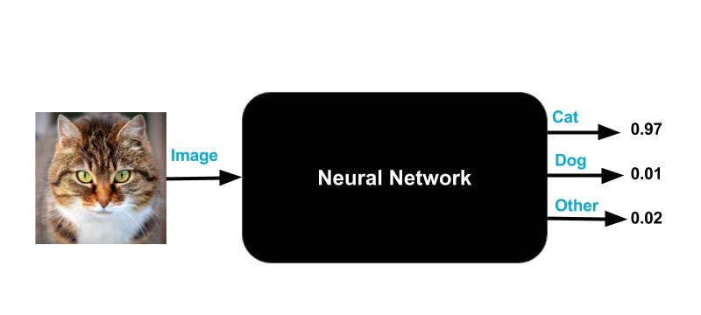
Deep Learning

Slide 6
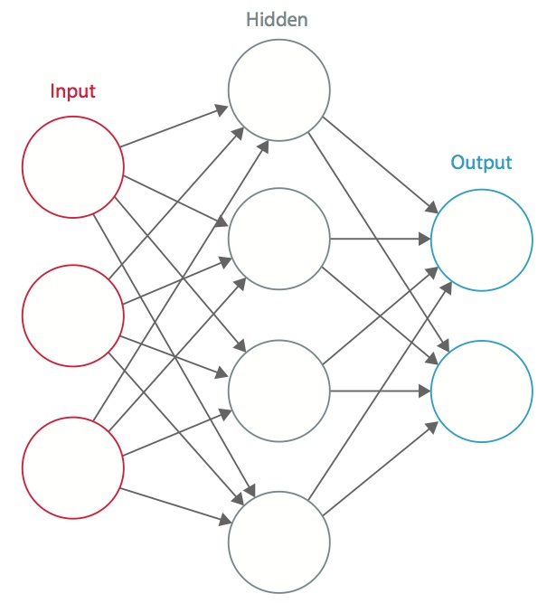
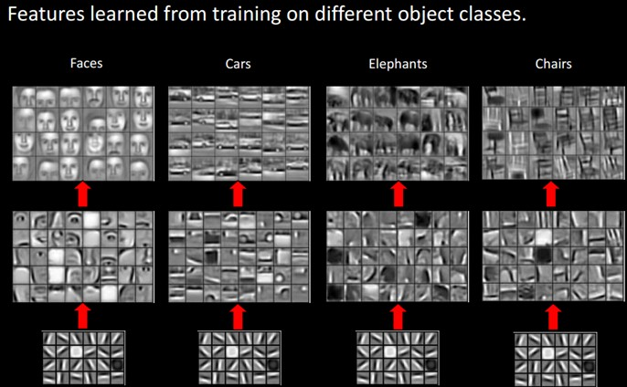
Deep Learning
字，句，段，章，篇

Slide 7
Deep Learning
Based on Neural Networks
Training the neural network simply means finding the right knob settings.
What can it do?
Computer Vision
Speech Recognition
Natural Language Processing
Audio Recognition
Machine Translation

Slide 8
Deep Learning
TensorFlow
Theano
Keras
PyTorch
dlib

Slide 9
Deep Learning
Image Recognition using Convolutional Neural Network

Slide 10
References
http://www.learnopencv.com/image-recognition-and-object-detection-part1/
http://image-net.org/index
http://cs231n.github.io/
http://blog.csdn.net/zouxy09/article/details/8775488
http://vis-www.cs.umass.edu/lfw/
https://github.com/davidsandberg/facenet
https://colah.github.io/posts/2014-07-Conv-Nets-Modular/
http://neuralnetworksanddeeplearning.com/chap1.html
https://zhuanlan.zhihu.com/p/24567586

Slide 11
Datasets
Labeled Faces in the Wild dataset (LFW)
http://vis-www.cs.umass.edu/lfw/
YouTube Faces (YTF)

Slide 12
Handwritten
https://github.com/tensorflow/tensorflow/blob/r1.5/tensorflow/examples/tutorials/layers/cnn_mnist.py
http://yann.lecun.com/exdb/mnist/

